Slide 1
Mood Miners
By Alexis Ambriz, Samarth Sharma, Joash Muganda and Justin Cho

Slide 2
AGENDA
​Primary Goal
SEMMA Methodology
Sampling
​Exploring
Modification
Modeling
Assessing
​Experiments, Failure, and Future Scope

Slide 3
PRIMARY GOAL
The objective is to perform sentimental analysis (emotion and its intensity recognition) based on audio data incoming in the .wav format. We worked on the ravdess dataset to perform sentiment analysis.
Dataset Link: ravdess-audio-dataset

Slide 4





SEMMA Methodology
Sample
EXPLORE
MODIFY
MODEL
ASSESS
Selecting representative data
Analyzing and understanding data
Preparing and refining data
Building predictive algorithms
Evaluating model performance

Slide 5
Sampling
The audio wav files were named in such a way that they acted as metadata providing seven identifiers: example: 03-01-06-01-02-01-12.wav These seven identifiers specify the Modality, Vocal channel, Emotion, Emotional intensity, Statement, Repetition, and Actor, respectively.
In this phase first we tried to extract the metadata identifiers from name and Audio features such as mfcc, spectral features, rmse, tempo, etc through raw data and sampling rate using a small sample of data using Python’s librosa library.
As the attempt to extract the data was successful for a sample of data, the same data extraction technique was applied to the whole audio dataset. Thus, the dataset is now ready for exploration.
Note: The target variables in this dataset are the identifiers Emotion and Emotional Intensity.

Slide 6
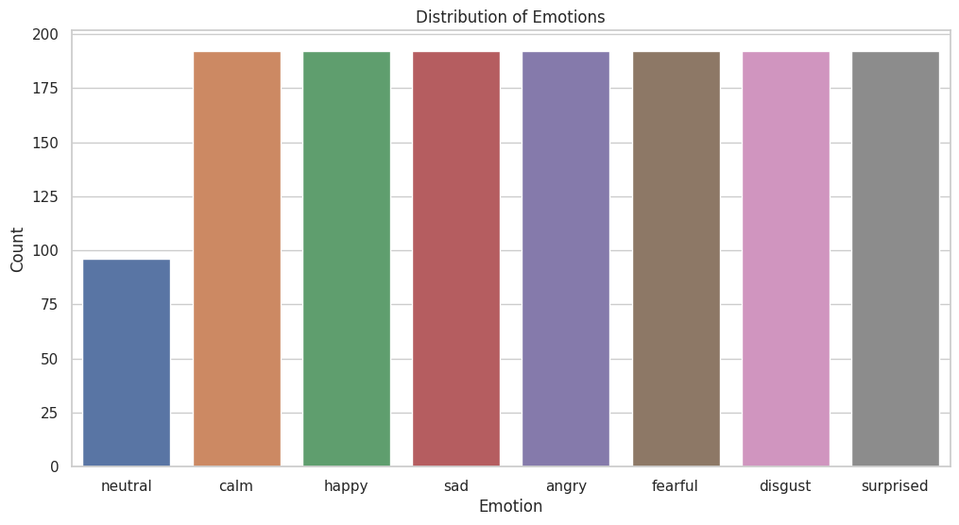
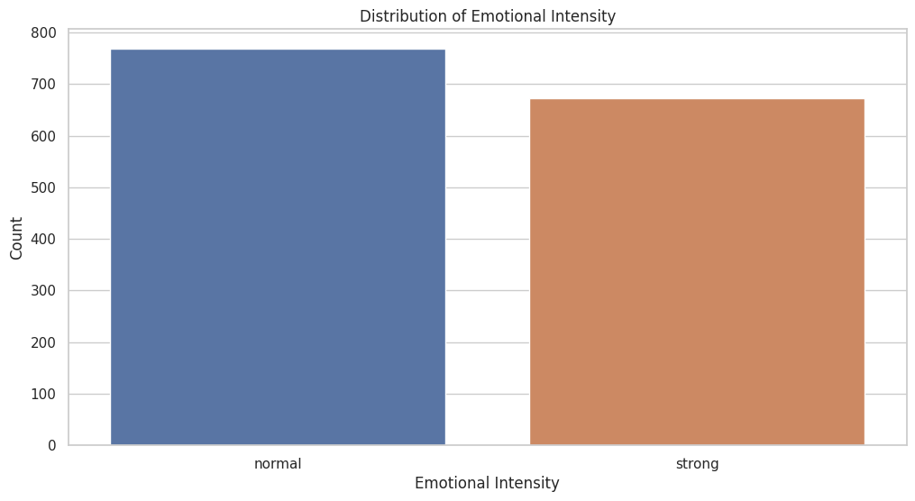
Exploring
During the exploration phase we came across various features which had constant values or almost negligible correlation with the target variable and thus can be dropped during the modification phase.
Also, there were features with list or list of lists as entries that cannot be used directly as inputs for machine learning models and thus must find a way for their numeric representation.
Moreover, emotions (1 = neutral, 2 = calm, 3 = happy, 4 = sad, 5 = angry, 6 = fearful, 7 = disgust, 8 = surprised) are encoded from 1 to 8, but the data is nominal (not ordinal), thus we can consider one hot encoding it. On the other hand, emotional intensity (1-normal, 2-strong) is a binary classification task so there’s no need for any encoding.
Furthermore, the target variables are well-balanced but have a very low correlation (0.14):

Slide 7
Modifications
Based on insights gained from the exploration phase, various features that would not contribute to the classification of the target variables were dropped.
To capture the essence of the data in the form of a list or list of lists, a statistical summary (mean, median, standard deviation, min, max) was extracted.
The data was then standardized.
As the correlation between the target variables ‘emotion’ and ‘emotional intensity’ is low, to avoid multiclass classification, the data is split into two different datasets. One with target variable emotion, and another with target variable emotional intensity.

Slide 8
Modeling
The dataset for both the classification tasks was split in an 80-20 train-test split ratio.
Various models were tried for both classification tasks considering the ‘No Free Lunch Theorem’.
For ‘emotion’ classification as well as ‘emotional intensity’ classification the best-performing model came out to be a random forest classifier.
Post hyperparameter tuning the model to classify emotion had an accuracy score of 64.58%.
Post hyperparameter tuning the model to classify emotional intensity had an accuracy score of 79.86%.

Slide 9
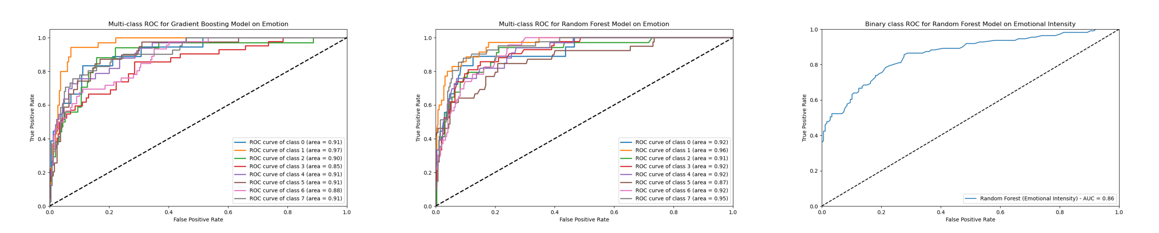
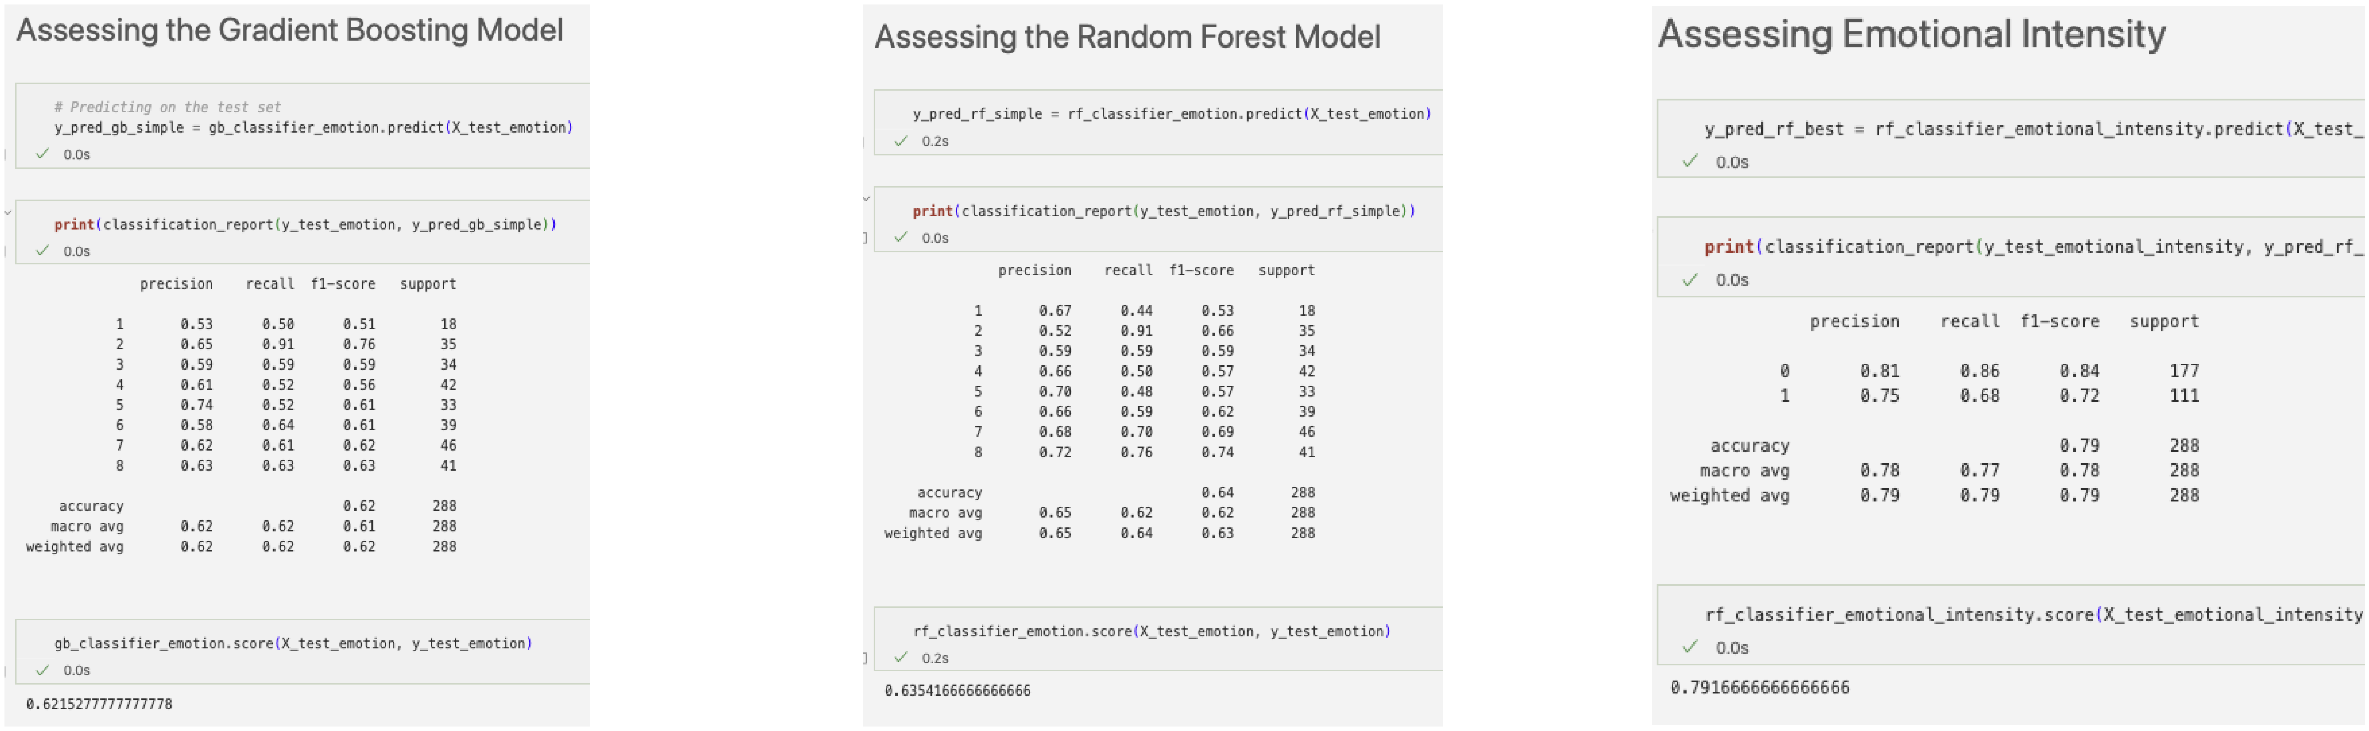
Assessing
Emotion Classification using Random Forest
Emotional Intensity Classification using Random Forest

Slide 10
Experiments, Failures, and Future Scope
Failures: Tried to build sequential neural network models such as ANN and LSTM for the classification of emotion class. But the results were poor (15% accuracy) which in this case was like a coin flip as there are 8 classes (12.5 % probability of a random guess being correct).
To conclude, we successfully created machine learning models using the SEMMA methodology to determine one of eight different types of emotion and the intensity of that emotion taking in the raw audio data and processing it.
Future Scope: The problem was tackled using the machine learning algorithms which performed well but still have a good scope for improvement. Neural networks have been proven exceptionally well in the domain of audio-related tasks. So, the problem can be reattempted with a deep learning approach such as Long Short-Term Memory is a type of Recurrent neural network and Convolutional Neural networks.

Slide 11
THANK YOU

